Slide 1


Advanced Compiler Code Generator Using Data Dependency and Flow Graph Optimization
[CSA 1412] [Compiler Design for Quantum Hardware]
Saveetha School of Engineering
Sruthi B (192421155)

Slide 2
INTRODUCTION
This project is about creating an advanced compiler code generator.
Compilers sometimes produce code that works but is not very efficient.
Problems like extra instructions and bad ordering can slow down programs.
The project uses data dependency and flow graph optimization to fix these issues.
The main goal is to make the generated code faster and more efficient.

Slide 3
OBJECTIVES
The project aims to create an advanced compiler code generator that produces faster and more efficient machine code.
It focuses on using data dependency analysis and flow graph optimization to reduce unnecessary instructions and improve code quality.
The problem being addressed is that traditional compilers often generate code that works but is not well-optimized, leading to slower program execution.
Issues such as redundant instructions, poor instruction ordering, and inefficient control flow need to be fixed for better performance.
The expected outcomes include improved code efficiency, better instruction scheduling, smoother control flow, and faster overall program execution

Slide 4
EXISTING SYSTEM
Traditional compilers translate high-level code into machine code without advanced optimization.
They often generate redundant instructions and inefficient code execution.
Control flow and data dependencies are not fully analyzed, leading to slower performance.
Instruction ordering may be poor, causing delays and wasted resources.
Overall, existing systems produce correct code but not highly optimized or efficient code.

Slide 5
Literature Review / Background
S. NO | DETAILS OF THE JOURNAL | ALGORITHM USED | ADVANTAGES | DISADVANTAGES
1 | Aho, A. V., Lam, M., Sethi, R., & Ullman, J. (2006). Compilers: Principles, Techniques & Tools. Pearson. | Data-flow analysis, dependency graphs, DAG-based optimization | Foundational techniques for modern code generators; strong theoretical grounding | Not focused on modern JIT or heterogeneous architectures
2 | Muchnick, S. (1997). Advanced Compiler Design and Implementation. Morgan Kaufmann. | Control-flow graph (CFG) + data-dependency-based global optimizations | Comprehensive treatment of CFG and data-flow optimizations used in back-end compilers | Outdated for multi-core, GPU-based optimization strategies
3 | Cooper, K., & Torczon, L. (2011). Engineering a Compiler. Morgan Kaufmann. | SSA (Static Single Assignment), def-use chains, dependency flow optimization | SSA simplifies dependency tracking; improves optimization accuracy | SSA conversion overhead; requires additional memory
4 | LLVM Team (2020). LLVM Compiler Infrastructure Documentation. | Modern IR with SSA, data-dependency graphs, machine-level scheduling | Industry-grade optimizer; modular; highly tunable code generation | Complex IR; steep learning curve; heavy compilation time for large systems

Slide 6
PROPOSED SYSTEM
The proposed system is an advanced compiler code generator that uses data dependency analysis and flow graph optimization.
It analyzes the relationships between variables to avoid redundant instructions.
It optimizes the control flow graph to reduce unnecessary branching and improve execution paths.
The system generates more efficient and faster machine code compared to traditional compilers.
Overall, it improves program performance, resource usage, and instruction-level parallelism.

Slide 7
METHODOLOGY
The project uses basic tools like a programming language (Python) and simple compiler libraries.
The development approach is to analyze the code, find data dependencies, build the flow graph, apply optimizations, and generate the final code.
Data collection includes using sample programs to test and check how well the optimizations work.

Slide 8
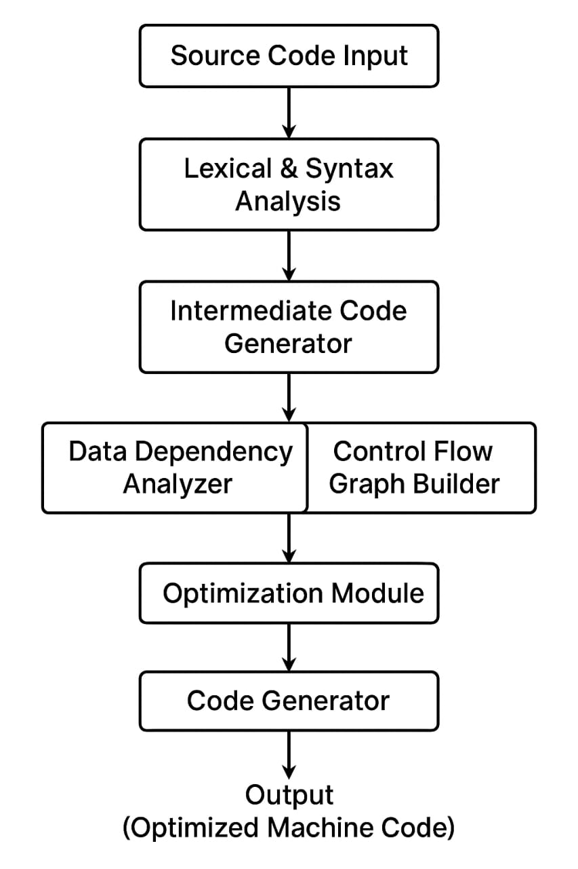
System Design / Architecture
Intermediate Code Creation – The compiler first converts source code into an intermediate form after lexical and syntax analysis.
Dependency & Flow Analysis – Data dependencies and control flow graphs are built to identify instruction ordering, parallelism, and optimization opportunities.
Optimized Code Generation – Using this analysis, the optimization module improves efficiency, and the code generator produces high-performance optimized machine code.

Slide 9
MODULES
Module 1 Data Dependency :
Tracks variable dependencies – which variable depends on which others.
Shows dependency graph – prints the graph in a readable format.
Module 2 Flow Graph Optimization :
Represents program flow – shows how basic blocks of code are connected.
Prints Control Flow Graph (CFG) – helps visualize branches (if-else, loops).

Slide 10
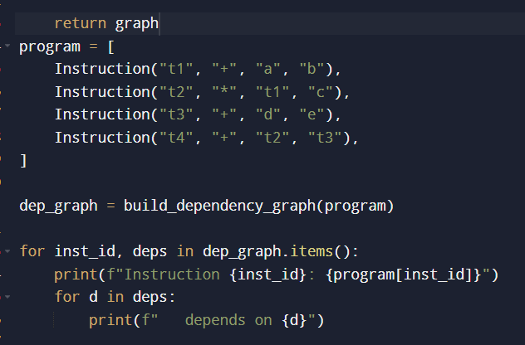
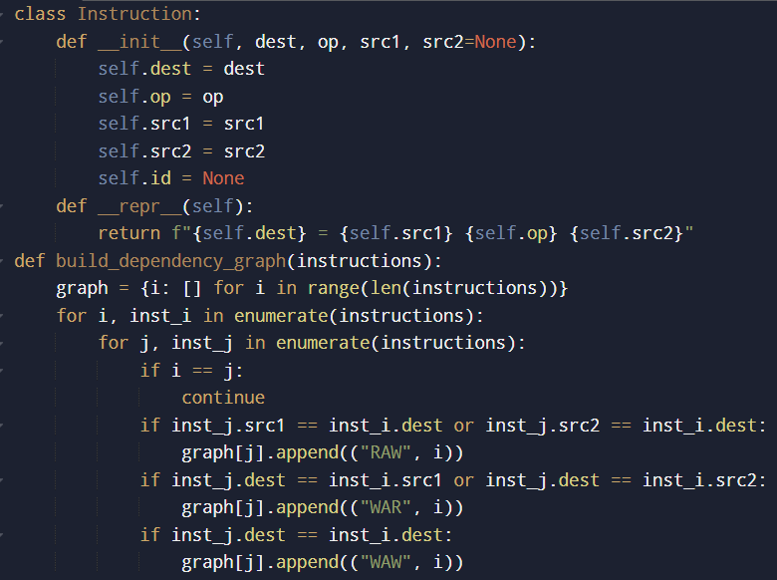
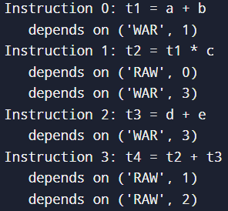
MODULE 1
OUTPUT :

Slide 11
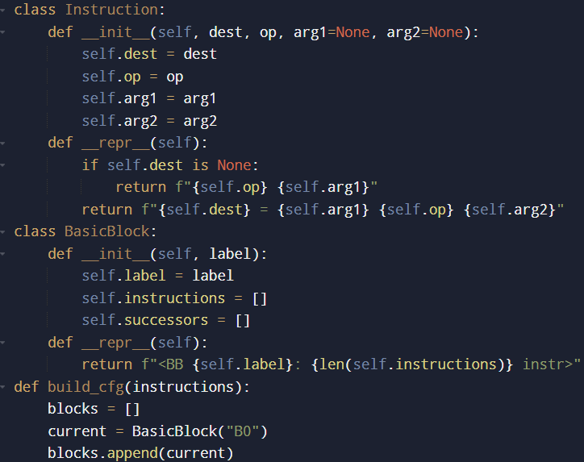
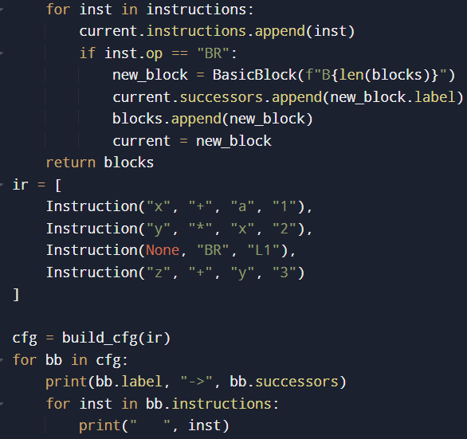
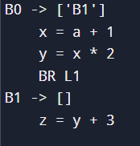
MODULE 2
OUTPUT :

Slide 12

IMPLEMENTATION
The image shows a polished interface of the Code Connection Explorer, a tool designed to visually analyze how different instructions in a program relate to one another.
It allows users to input code and then highlights how data flows from one step to the next.
A visually organized flow map is generated, making it easy to see which instructions rely on earlier values.
Color-coded indicators help distinguish reading, writing, and variable interactions. Overall, the tool provides a clear, professional way to understand code structure, improve debugging, and optimize program execution.

Slide 13




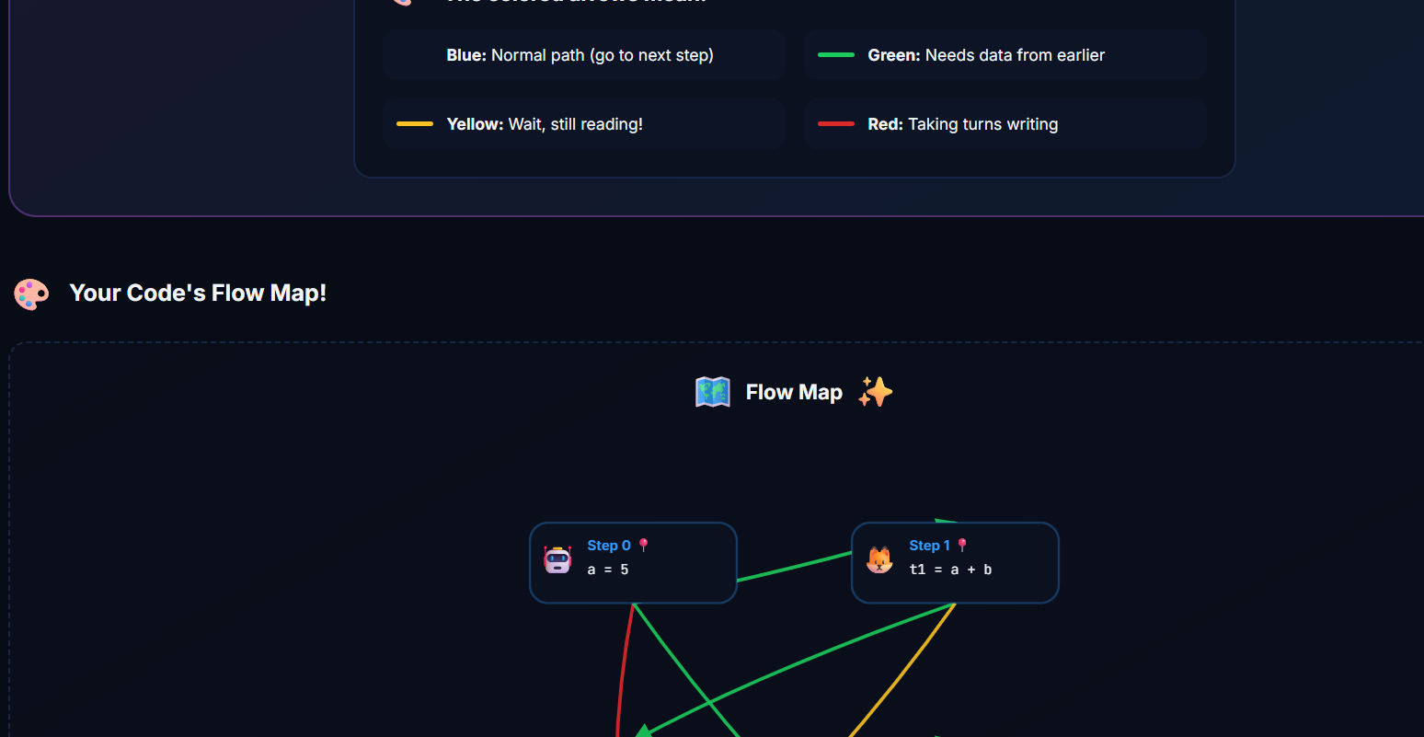




Slide 14
RESULTS & DISCUSSION
The project makes programs run faster and use fewer resources.
It reduces extra instructions and improves the order of code execution.
Compared to existing compilers, it produces more efficient and optimized code.
It uses memory and CPU more efficiently.
Results can be shown using simple charts and tables to compare performance.

Slide 15
Challenges & Limitations
Difficulty in analyzing complex data dependencies.
Challenges in building and optimizing the control flow graph.
Limited time and resources for testing large programs.
Ensuring optimizations do not affect the program’s correct behavior.

Slide 16
FUTURE SCOPE
Implement advanced optimization techniques like loop unrolling and instruction scheduling.
Improve the compiler’s user interface for easier use.
Add support for multiple programming languages.
Provide better visualization of data dependencies and control flow graphs.
Extend the system to handle large-scale and real-time applications.

Slide 17
CONCLUSION
The project develops an advanced compiler code generator using data dependency and flow graph optimization.
It improves the efficiency of generated machine code by reducing redundant instructions and optimizing execution flow.
The system analyzes data dependencies and control flow to produce faster and more resource-efficient programs.
Optimized code improves performance and resource utilization.
Data dependency and flow graph analysis are essential for advanced compiler design.
The project shows how intelligent code generation can outperform traditional compilers.

Slide 18
References
Aho, A. V., Lam, M. S., Sethi, R., & Ullman, J. D. (2006). Compilers: Principles, Techniques, and Tools (2nd ed.). Pearson.
Muchnick, S. S. (1997). Advanced Compiler Design and Implementation. Morgan Kaufmann Publishers.
Cooper, K. D., & Torczon, L. (2011). Engineering a Compiler (2nd ed.). Morgan Kaufmann.

Slide 19
Thank You!
Any Questions?

